Slide 1
The Kentucky Department of Revenue presented the following information at the Kentucky Society of CPA’s IRS Liaison Meeting on October 30, 2019. This presentation covered the responsibilities of the Office of the Taxpayer Ombudsman, recent regulatory action by the Department of Revenue as well as an update of income tax issues.
The information in this presentation was prepared from information the Department of Revenue possessed and believed to be accurate and relevant on the date of the meeting. This information does not constitute a final ruling, order, or determination of the Department of Revenue and cannot be appealed.

Slide 2
Kentucky Department of Revenue
KyCPA Society
IRS Liaison Meeting
October 30, 2019
Kentucky Department of Revenue • 501 High Street • Frankfort, KY 40601 • (502) 564-4581

Slide 3
INTRODUCTIONS
Jeremy Simpson
Taxpayer Ombudsman
Jessica S. Honican, CPA
Director of Corporation Tax Division

Slide 4
NEW TITLES
Melanie Bitzer Deputy Commissioner, Department of Revenue
Tammy Watts Executive Director of the Office of Processing & Enforcement
Joe Lancaster Executive Director of the Office of Property Valuation
Nick Harren Deputy Executive Director of the Office of Processing & Enforcement
Matt Smothermon Director of the Division of Operations
Stephanie Rich Director of the Division of Minerals Taxation and GIS Services
Kristi Kays Director of Application Development & Support
Kevin Miller Director of the Protest Resolution Division

Slide 5
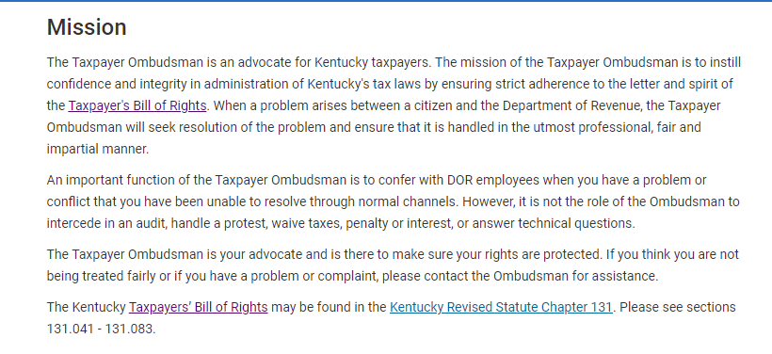
Office of the Ombudsman

Slide 6
Taxpayer Ombudsman – Telephone Inquiries

Slide 7
Integrated Tax System
The Department of Revenue (DOR) has contracted with Revenue Solutions, Inc. (RSI) to provide a COTS (Commercial Off The Shelf) solution for an integrated tax system.
This new solution will revolutionize how Kentucky processes and posts returns and payments. In addition to creating greater efficiency for DOR employees, this system will allow for a smoother taxpayer experience overall.

Slide 8
Integrated Tax System
The Problem: Current IT Landscape
116 Applications
84 are built on technologies that are now outdated/unsupported
90% of General Fund tax receipts are processed on systems developed in the 1970s and 1980s
Systems are not sufficiently flexible or scalable to fit DOR needs

Slide 9
Integrated Tax System
The Solution: One System for All
Once implemented, the new solution will integrate functionality for most all of the applications currently in use and be the system that DOR uses to maintain:
Registration Reporting Compliance
Taxpayer Information Return/Payment/Refund Processing Data Warehousing
Taxpayer Assistance Correspondence Document Management
Billing Collections Desk and Field Audit

Slide 10
Office of Tax Policy and Regulation
Published Revenue Procedures (RP) and General Information Letters (GIL)
RP-19-01 | Apportioned Trailer Exemption
RP-19-02 | Deferred Tax Deduction
RP-19-03 | Administration of Guidance (amended 7/26/19) Supersedes RP-17-01
GIL 19-01 | Historic Tax Credit
https://revenue.ky.gov/TaxProfessionals/Pages/Guidance.aspx

Slide 11
Office of Tax Policy and Regulation
Published Technical Advice Memorandums (TAMs)
TAM 18-06 | Deductibility of State Taxes
TAM 18-07 | Credit for Ad Valorem Tax Paid on Inventory (amended 11/26/18) Supersedes KY TAM 18-04
TAM 19-01 | Deductibility of IRC Section 67(e) Fiduciary Expenses
TAM 19-02 | Requirement to Pay ​Estimated Tax Installments
https://revenue.ky.gov/TaxProfessionals/Pages/Guidance.aspx

Slide 12
Sales and Excise Taxes Regulations
Regulations in Progress
24 regulations have been filed for amendment
Contractors (103 KAR 26:070)
Veterinarians and pet care service providers (103 KAR 26:090)
Admissions (103 KAR 27:010)
1 regulation has been filed to repeal (Pollution Control regulation)
Regulations in Queue to be Revised
Sales by civic clubs and similar organizations (103 KAR 27:170)
Towel and linen service (103 KAR 26:100)
Landscaping (new)

Slide 13
Miscellaneous Excise Tax Regulations
Regulations in Progress
103 KAR 2:030 (Policies and circulars relating to inheritance tax) cleanup
103 KAR 40:050 (Transportation) technical cleanup
103 KAR 40:010 (Maintaining Records) changes records retention from 3 years to 4 years
103 KAR 41:040 (Subjobbers, vending machine operators, and unclassified acquirers) removed subjobbers and unclassified acquirers due to 41.220
103 KAR 41:100 (Segregation of cigarettes) added clarification
103 KAR 41:110 (Sample of cigarettes) changes records retention changed from 2 years to 4 years
New 103 KAR 41.220 (Applications, stamp orders, returns, reports, and statements to be filed electronically- Waiver) mandates e-filing for cigarette and tobacco products
103 KAR 43:010 (Accountable Losses) technical cleanup
Regulations Filed for Repeal
103 KAR 40:090 (Consumer tax rates)
103 KAR 41:030 (Wholesalers, resident and nonresident)
103 KAR 41:050 (Transporters)
103 KAR 41:060 (Diversified Operators)
103 KAR 41:200 (Manufacturers Report)
103 KAR 43:110 (Refund gasoline and special fuel use)
Regulations in Queue for Revision or Repeal
103 KAR 2:005 (Life expectancy table)
103 KAR 43:100 (Farm Tractor Defined)

Slide 14
Property Tax Regulations
Regulations Promulgated
103 KAR 8:110 - Apportioned vehicles
103 KAR 8:130 - Consolidates Chapter 8, Sections 140 & 150
Regulations in Progress
103 KAR 8:160 - Valuation of landfills
103 KAR 8:170 – New Pollution control facilities exemption
Repealed Regulations
103 KAR 5:150 - Procedures for the removal of a PVA from office
103 KAR 7:030 - City adoption of county assessment
103 KAR 8:010 - Nonresident watercraft allocation
103 KAR 8:140 - Ad valorem taxation of machinery actually used in the manufacturing of crushed stone, sand, and gravel
103 KAR 8:150 - Ad valorem taxation of machinery actually used in the manufacturing of hot mix asphalt

Slide 15
Income Tax Regulations
Regulations Promulgated
103 KAR 15:050 - Filing dates and extensions
103 KAR 16:270 - Receipts factor - market based sourcing
103 KAR 16:400 - Unitary combined
103 KAR 16:250 – NOL computation & deduction for corporations
103 KAR 16:200 - Consolidated corporation income tax returns
103 KAR 17:010 – Residence
103 KAR 17:020 – Combined individual returns
103 KAR 17:060 – Individual Income subject to taxation
103 KAR 17:100 – Division of income between married individuals
103 KAR 17:130 – Military personnel; nonresident individuals
103 KAR 17:140 – Individual reciprocity; nonresidents
Regulations in Queue to be Revised
Apportionment – Receipts Factor (103 KAR 16:270)
To add financial institutions, banks, and savings and loans associations

Slide 16
Income Tax Highlights
2019 IRC reference date updated to December 31, 2018
IRC §179 expense deduction increased to $100,000 for Kentucky in 2020
2019 estimated tax rules and penalties changed to generally follow federal
Four installments at 25% each
Declaration Penalty replaced with “Addition to Tax” Penalty
Individual Itemized Deductions Restored (Form 740, Schedule A)
Investment interest deduction under IRC Section 163
Gambling loss deduction under IRC Section 165(d)
New Income Gap Tax Credit for individuals eligible for Family Size Tax Credit due to tax rate change to a flat 5% (for 2019 & 2020 only)
Kentucky Extends C-Corporation Due Date from to 7 months (for extensions filed on or after June 27, 2019)

Slide 17
Office of Income Taxation
Individual Forms Revisions:
Form 740 and 740-NP
Changed to 3 pages and 4 pages respectively to incorporate additional line items and make the forms easier to scan
Schedule A
Restored itemized deductions for investment interest and gambling losses
Schedule P
Added flowchart to determine if Schedule P should be filed
Schedule KNOL
To track net operating loss and apply the 80% limitation
Forms 2210-K and 740ES
To follow federal rules & the addition to tax penalty

Slide 18
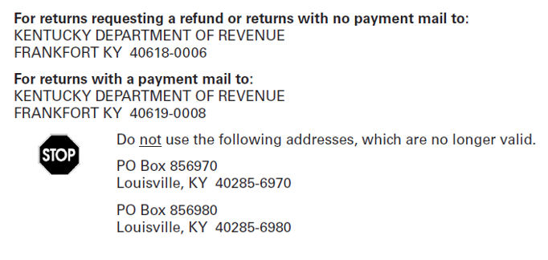
Individual Income Tax – Address Change
New Mailing Addresses for
Individual Income Tax Returns

Slide 19
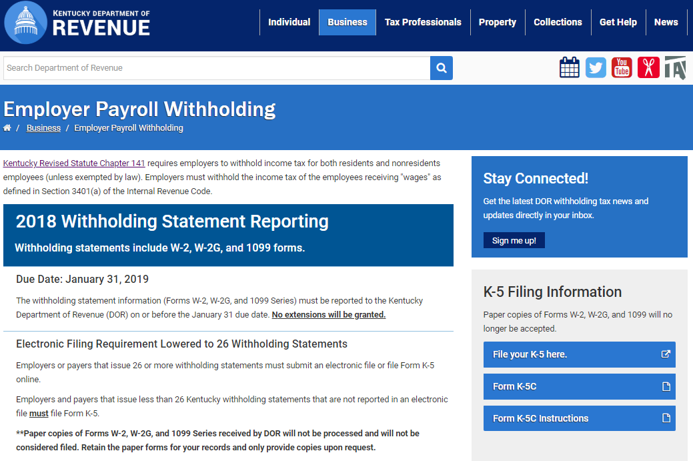
Office of Tax Policy and Regulation
https://revenue.ky.gov/Business/Pages/Employer-Payroll-Withholding.aspx

Slide 20
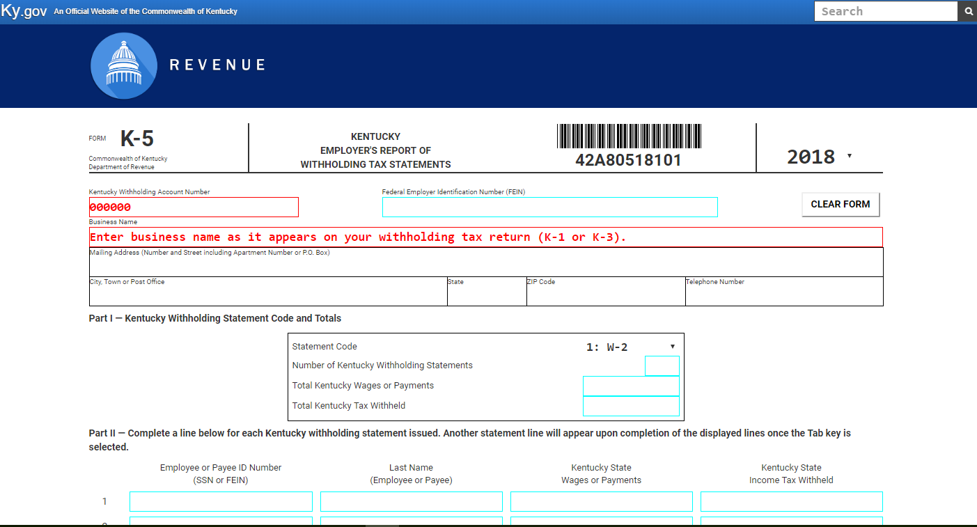
Office of Tax Policy and Regulation
https://revenue.ky.gov/Business/Pages/Inventory-Tax-Credit.aspx

Slide 21
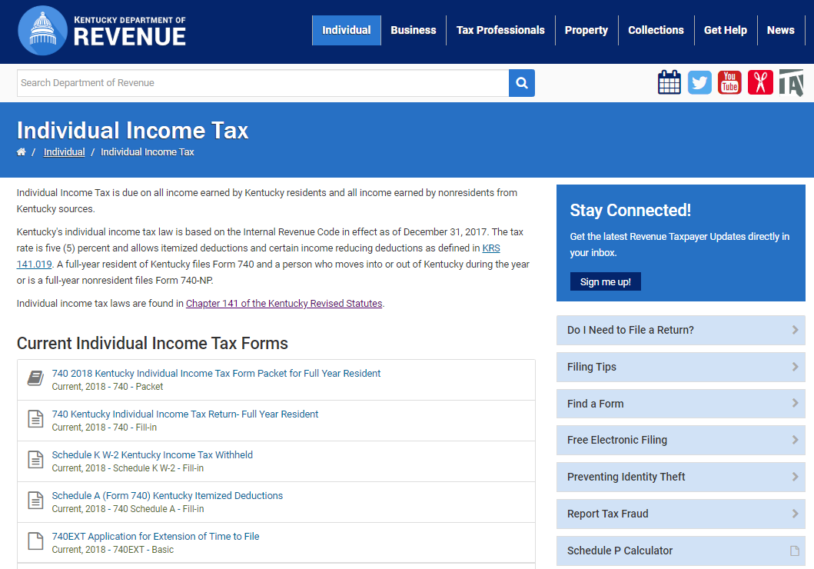
Office of Tax Policy and Regulation
https://revenue.ky.gov/Individual/Individual-Income-Tax/Pages/default.aspx

Slide 22
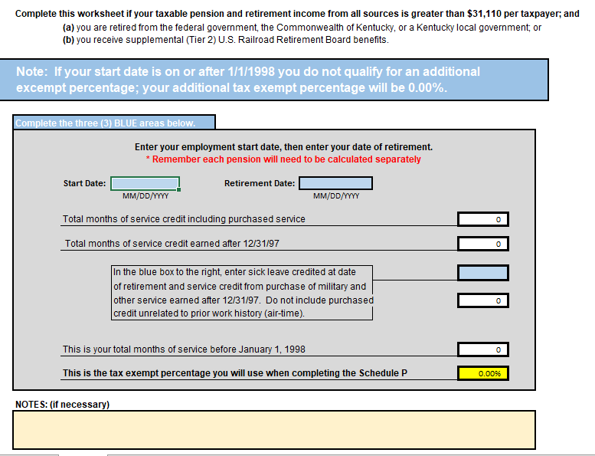
Individual Income – Schedule P Calculator

Slide 23
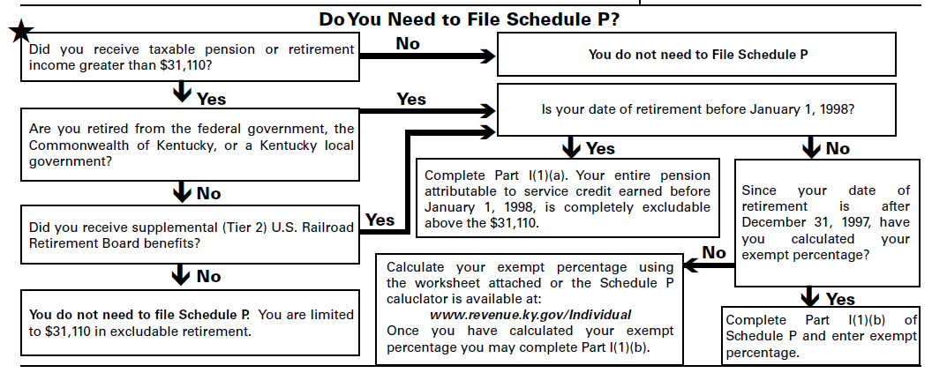
Individual Income – Pension Exclusion

Slide 24
New Way to File Individual Income Tax Returns
KY File
KY File will be available at www.revenue.ky.gov
Electronic equivalent of a paper form
Provides basic mathematical and error checks
Does not ask about or explain tax situations
Federal forms should be completed before using KY File
No Charge = FREE
Watch www.revenue.ky.gov for updates and links for KY File

Slide 25
Office of Income Taxation
Corporate and Pass-through Forms Changes:
New Form 720U – Kentucky Unitary Combined Corporation Income Tax and LLET Return
Supporting Schedules U1 through U10
New Form 722 – Election to File Consolidated Kentucky Corporation Income and Limited Liability Entity Tax Return
Revised Schedule KNOL - To track NOL and apply the 80% limitation
Revised Forms 2220-K and 720ES – to follow federal rules & addition to tax penalty
Revised Forms 725, 725–EZ, and 765 - Updated to include income tax payment summary for companies with tax credits that require income tax paid at entity level
Other Forms Changes
KIRA–SP, KJDA–SP, KJRA–SP, and KBI–SP updated to include local wage assessments claimed

Slide 26
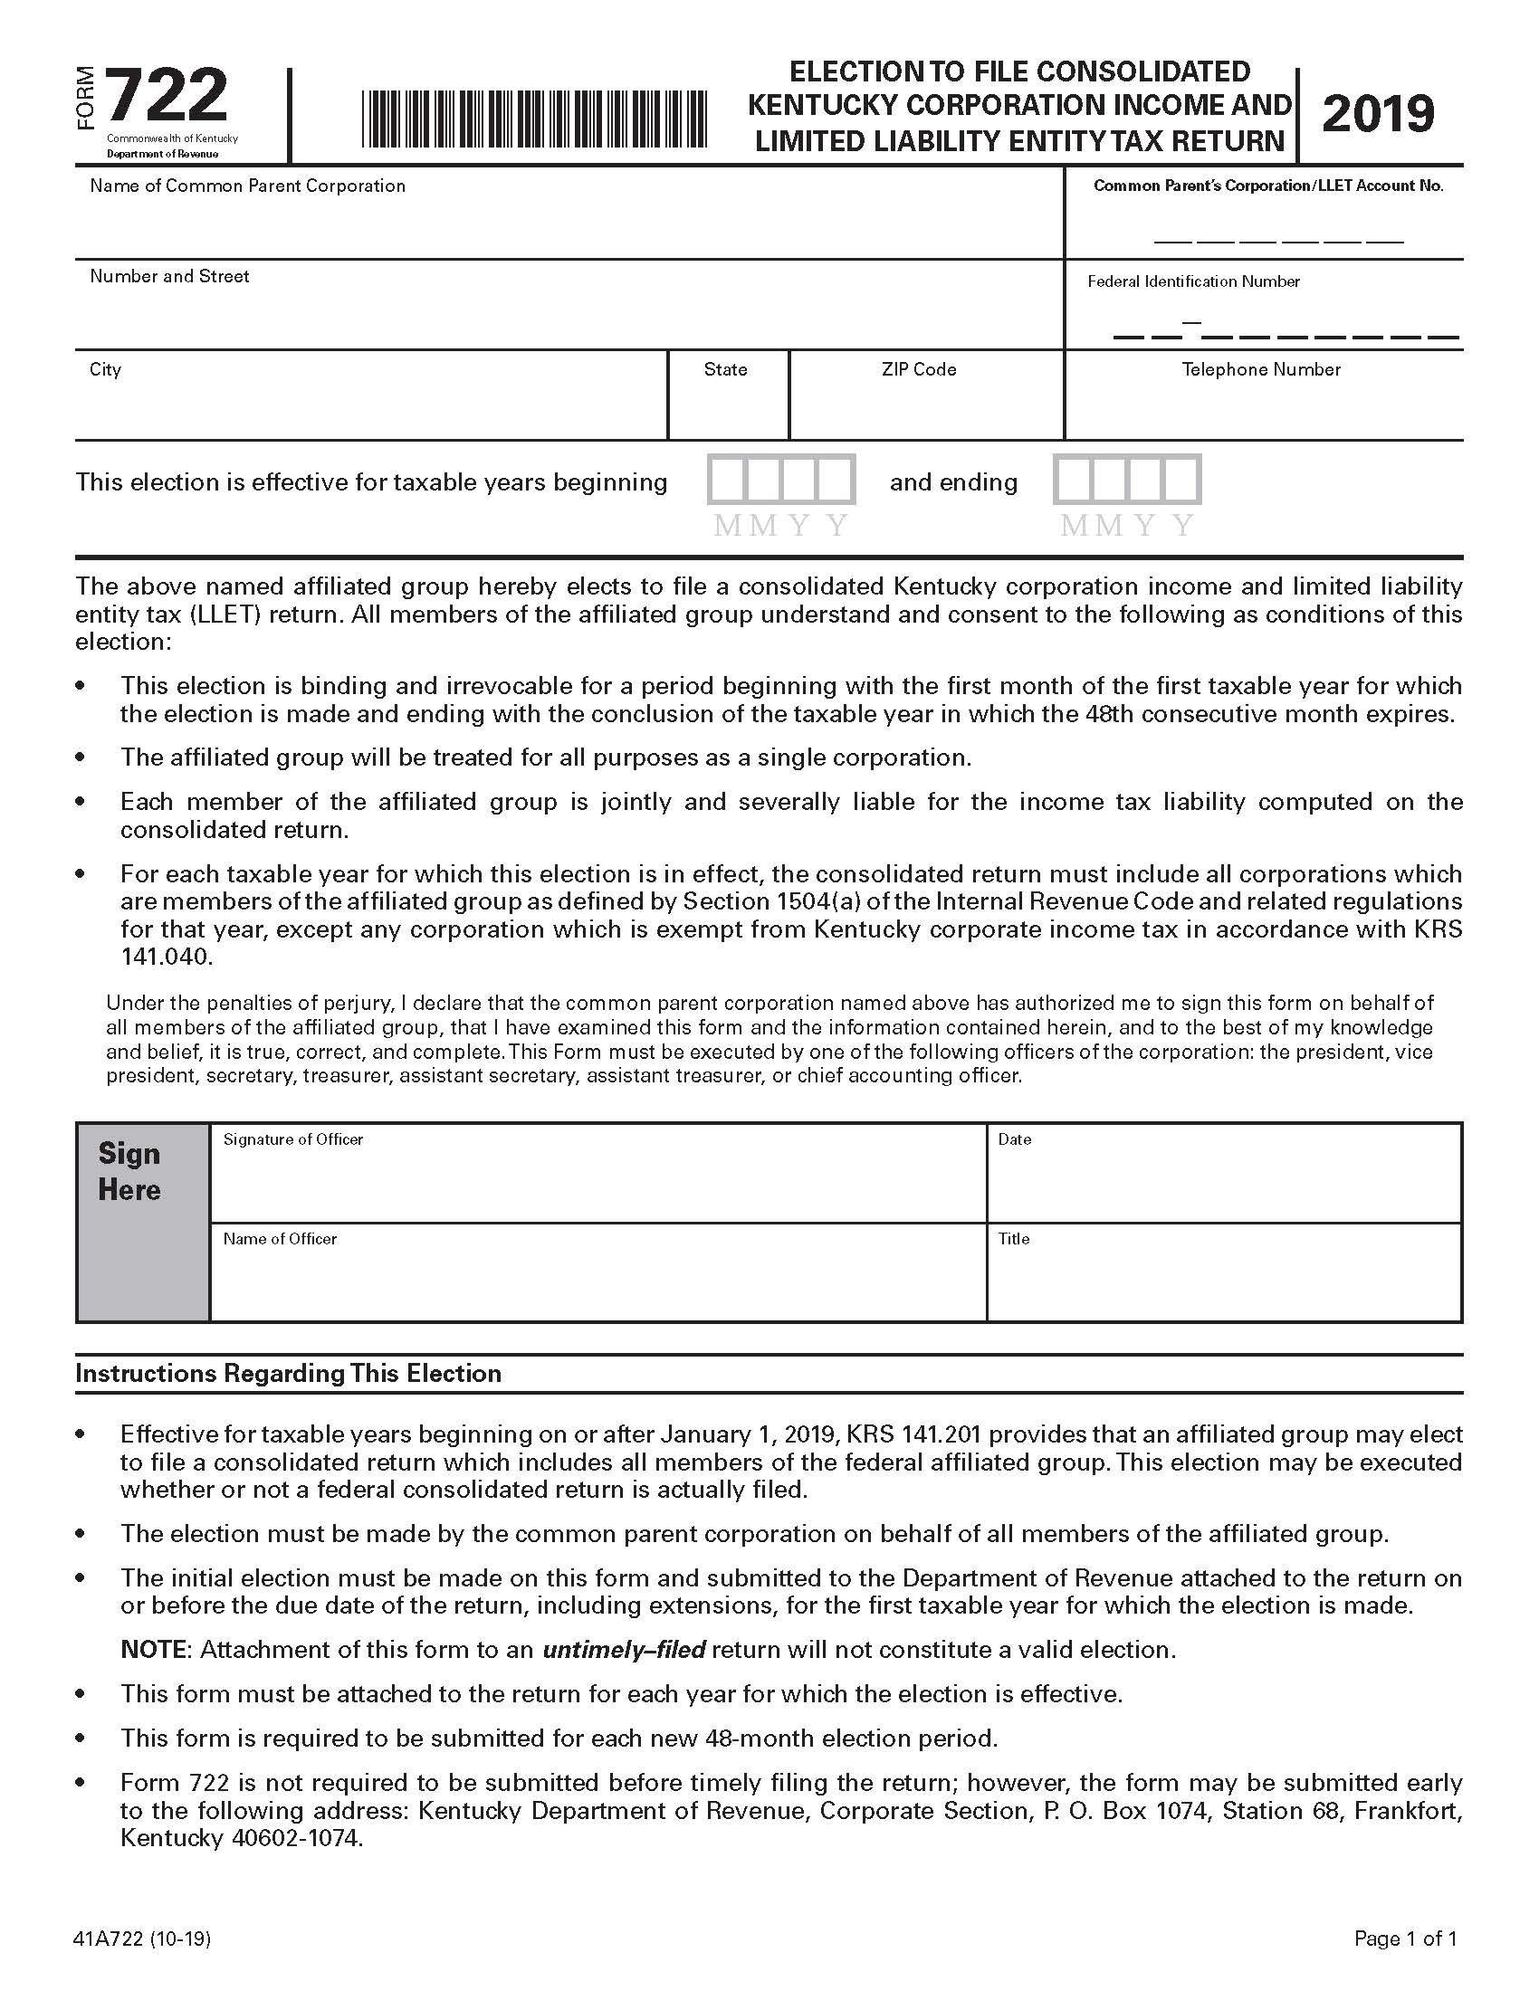
Form 722
Election to File Consolidated Kentucky Corporation Income and Limited Liability Entity Tax Return
The initial election must be made on this form and submitted to the Department of Revenue attached to the return on or before the due date of the return, including extensions, for the first taxable year for which the election is made.

Slide 27
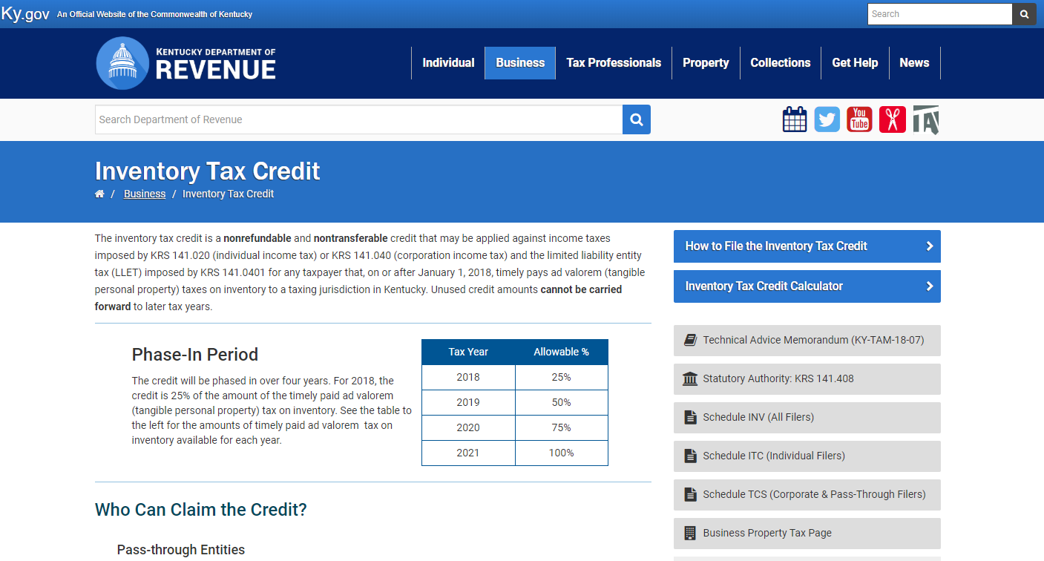
Office of Tax Policy and Regulation
https://revenue.ky.gov/Business/Pages/Inventory-Tax-Credit.aspx

Slide 28
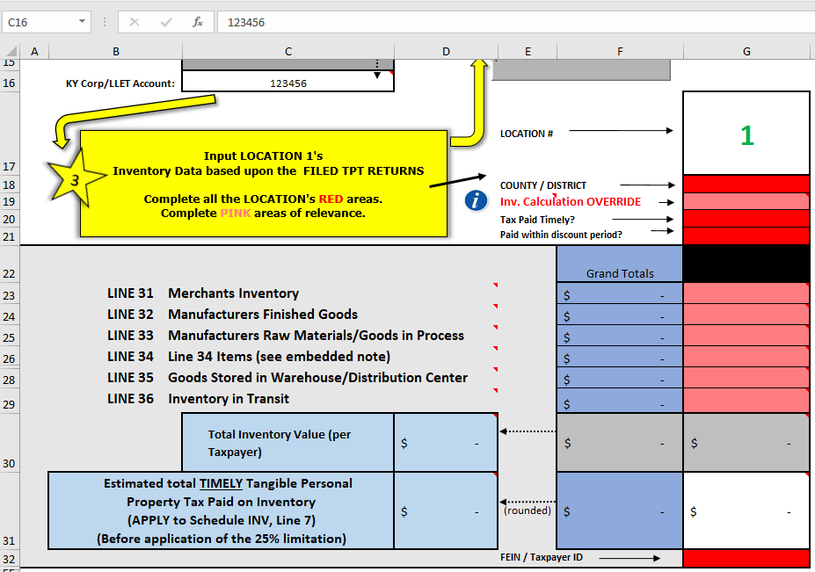
Office of Tax Policy and Regulation
https://revenue.ky.gov/Business/Pages/Inventory-Tax-Credit.aspx

Slide 29
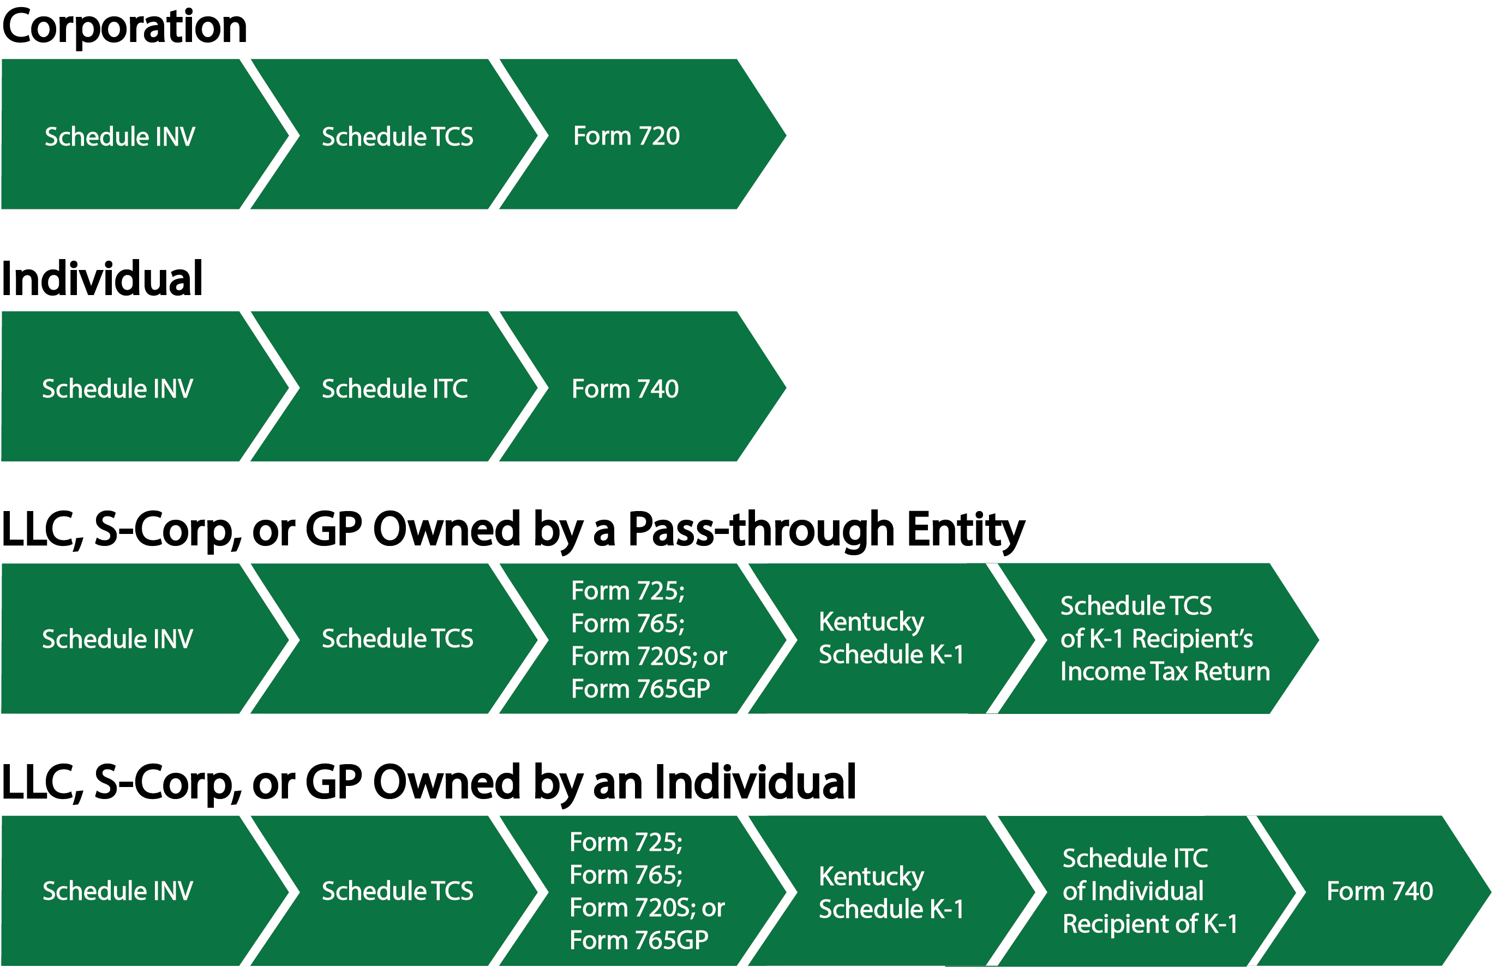
Office of Tax Policy and Regulation
How the Inventory Tax Credit Flows on Tax Forms & Schedules
https://revenue.ky.gov/Business/Pages/Inventory-Tax-Credit.aspx

Slide 30
Office of Field Operations
Recordkeeping Reminder
Sales & Use Tax: Certain services subject to tax under HB487
Resource: www.taxanswers.ky.gov
Tangible Property Tax:
Compliance reviews (non-filers / tangible property tax returns not matching income tax returns)
Corporate Income Tax
Related Party Expenses & Net Operating Losses
Individual Income Tax
Activities not engaged in for profit

Slide 31
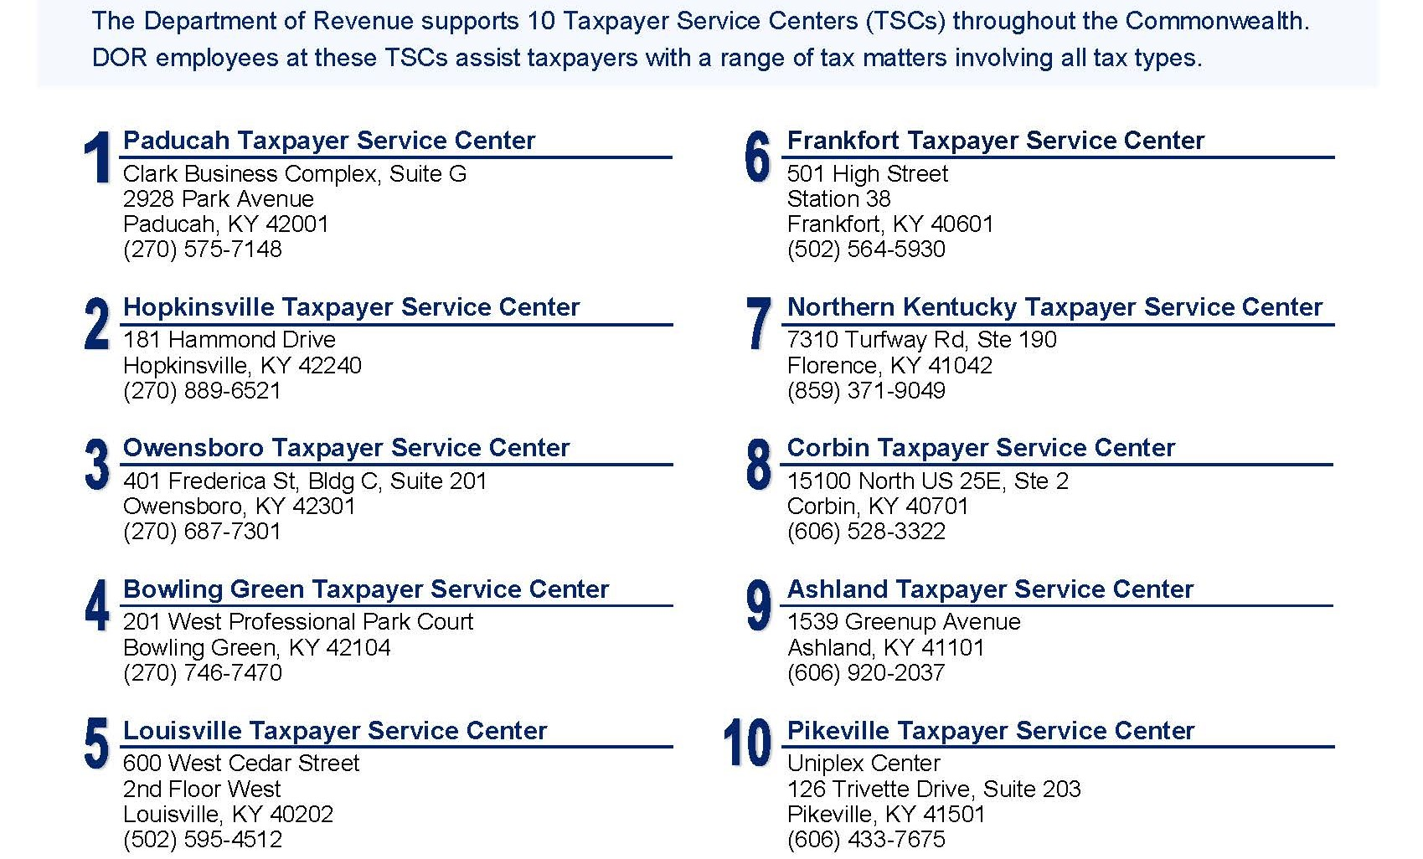
Office of Field Operations

Slide 32
October 30, 2019 Speaker Contact Information
Jeremy A. Simpson 844-751-5011 Jeremy.Simpson@ky.gov
Jessica S. Honican 502-564-7268 JessicaS.Honican@ky.gov
Kentucky Department of Revenue
501 High Street • Frankfort, KY 40601
(502) 564-4581

